Slide 1

Understanding the Components of Learning. A Classification Perspective.
6CS012 – Artificial Intelligence and Machine Learning. Lecture – 02

Slide 2

Learning Objectives:
Review key Machine Learning concepts from 5CS037.
Understand Logistic Regression for classification tasks.
Identify limitations of Logistic Regression.
Justify the need for Deep Learning.

Slide 3
What is Learning?

Slide 4
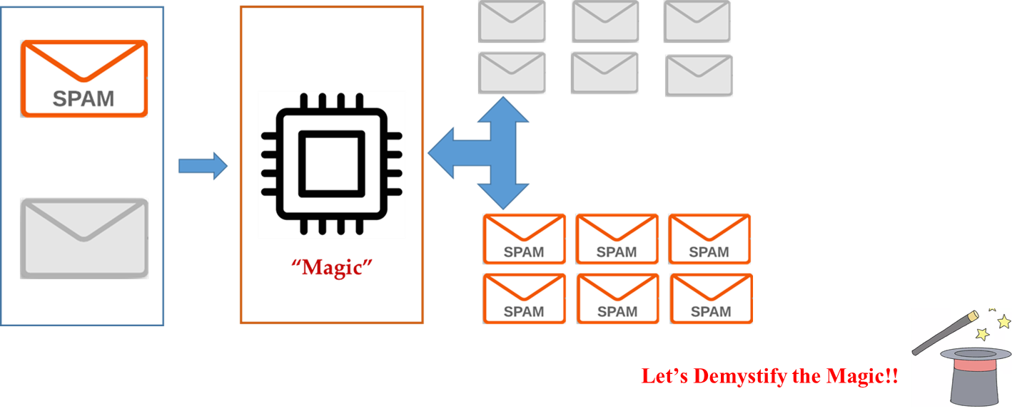
The Learning Problems.
Task-Example: Identify the spam emails!!!
(Program a machine that learns how to filter spam emails.)

Slide 5
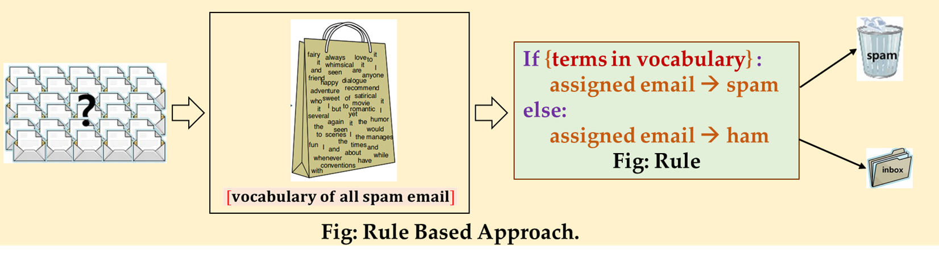
The Expert System – Rule Based.

Slide 6
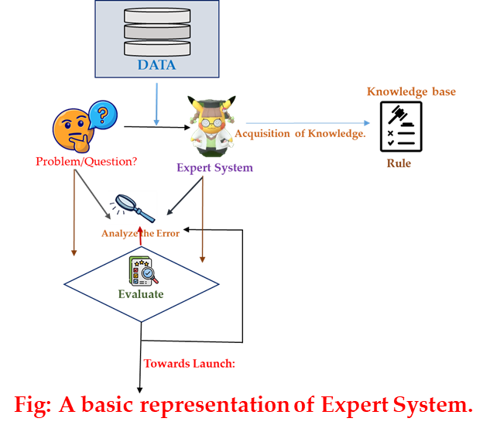
Limitations of Expert System
Interpretability: Rules are manually crafted and limited to specific domains.
Static: Cannot adapt to changing logic; rewriting required.
Shallow: Lacks deep understanding, relies on memorizing features of data.

Slide 7
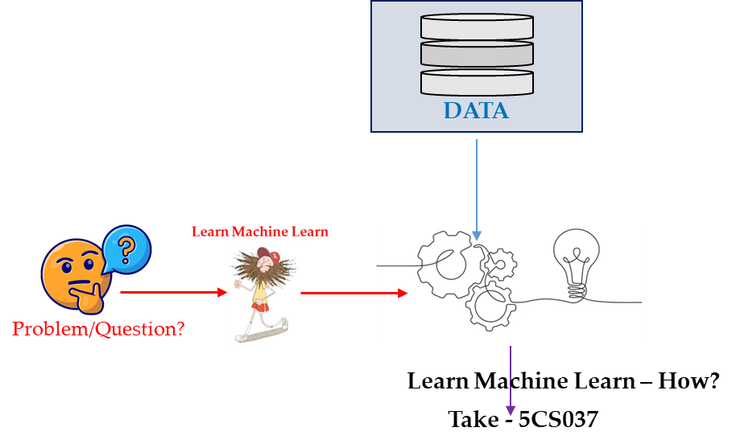
Learning from Data – Machine Learning
Instead of manually defining decision rules, machines learn from data:
Training data: Pairs of inputs (x) and outputs (y).
Examples
Videos labeled as "cat" or "no cat."
Emails labeled as "spam" or "not spam."

Slide 8
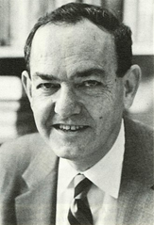

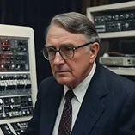
What is Machine Learning?
What Legend has to say about it?
“Learning is any process by which a system improves performance from experience”.
Herbert Simon
“Field of study that gives computers the ability to learn without being explicitly programmed.”
Arthur Samuel ,1959 (an AI pioneer at IBM and founding fellow of Association for the advancement of Artificial Intelligence).
Definition by Tom Mitchel(1998):
Machine Learning is the study of algorithms that:
Improve their performance P
At some task T
With experience E
A well defined learning task is given by <P, T, E>.

Slide 9
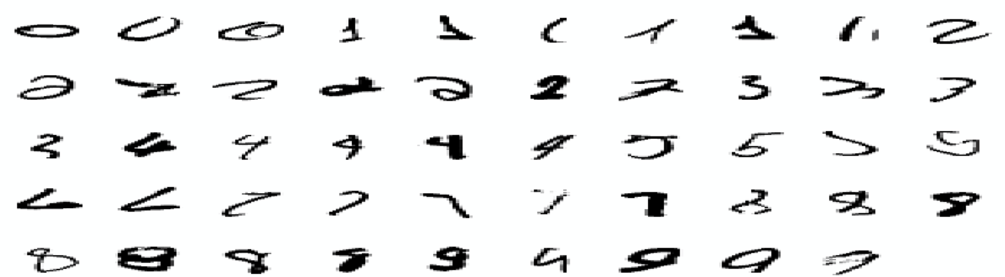
Tasks that Require Machine Learning.
What makes a 2?
What distinguishes a 2 from 7?
In Mitchel Tom Definition:
T: Recognize hand written digits.
P: Percentage of digit recognized correctly.
E: Database of human-labeled images of handwritten digits.

Slide 10
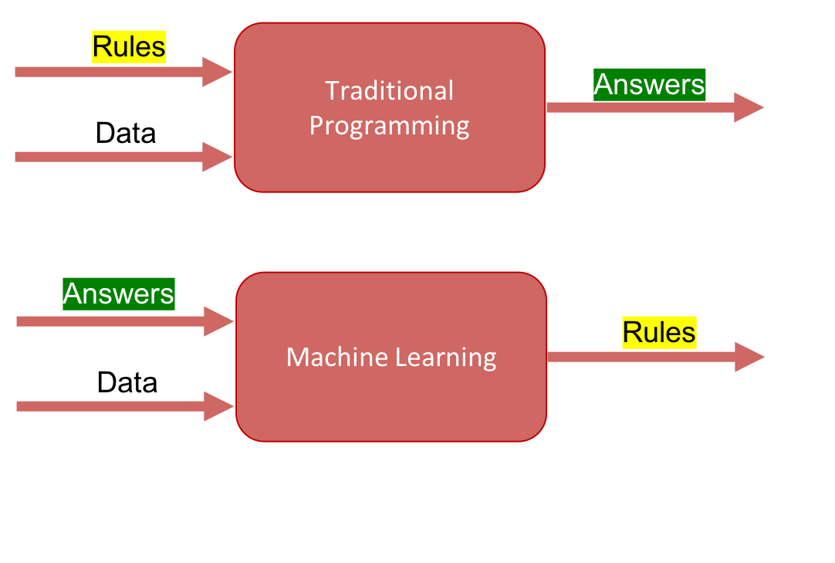
Machine Learning Vs. Traditional Programming.

Slide 11

What isn’t Machine Learning?
Powerful but not magical!
Not Exactly Artificial Intelligence
Limitations:
Not a path to robot singularity
Struggles with abstract reasoning
Not understanding, just processing

Slide 12

Core Components in Machine Learning

Slide 13
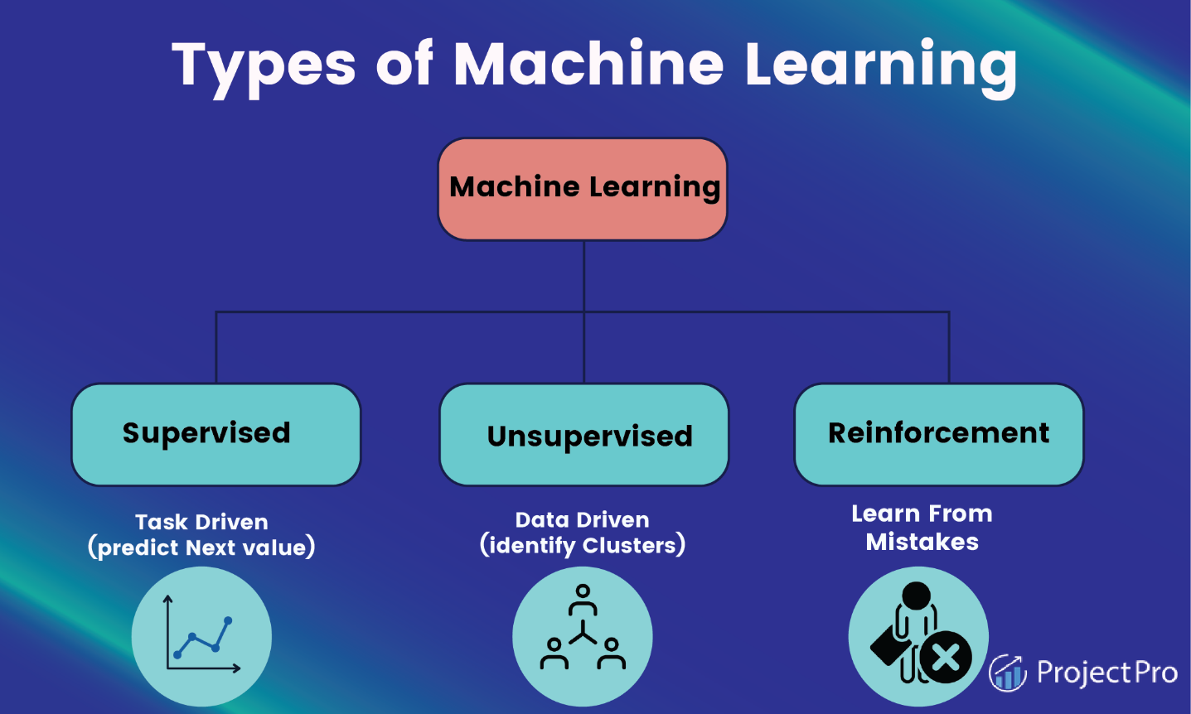
Types of Machine Learning
Many different problem classes in machine learning.
Vary according to what kind of data is provided and what kind of conclusions are to be drawn from it
Some popular kinds
Supervised Learning
Unsupervised Learning

Slide 14
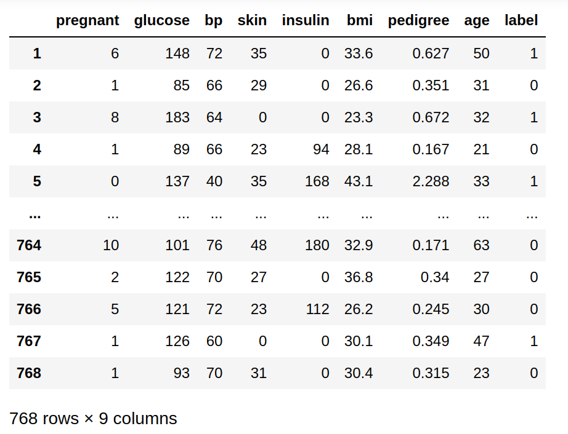
Supervised Machine Learning
Uses Labeled Dataset
Types
Classification
Regression

Slide 15
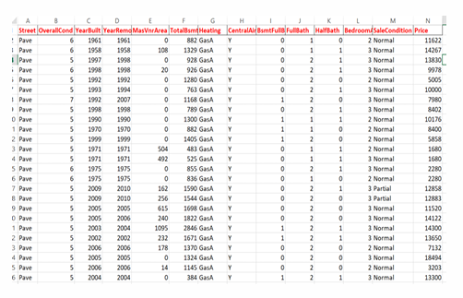
Regression
Predicts continuous numerical values
Finds relationship between input features and target variable
Input: Numerical features
Output: Continuous numeric prediction
Goal: Minimizes prediction error

Slide 16
Classification
Predicts discrete class labels
Maps input data to predefined categories
Input: Features (attributes)
Output: Discrete class/category
Learns from labeled training data

Slide 17
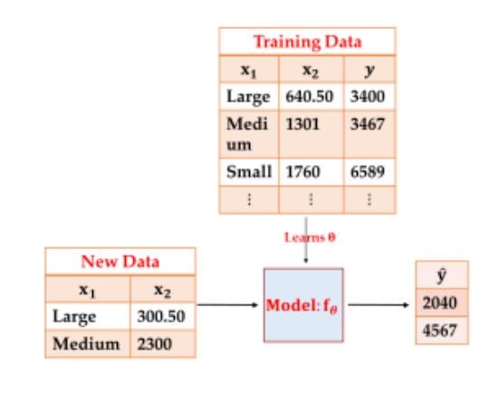
What do we want?
Learning
Finding patterns in training data to create a model that makes predictions.
Inference
Using the model to predict and interpret outcomes for new data.

Slide 18
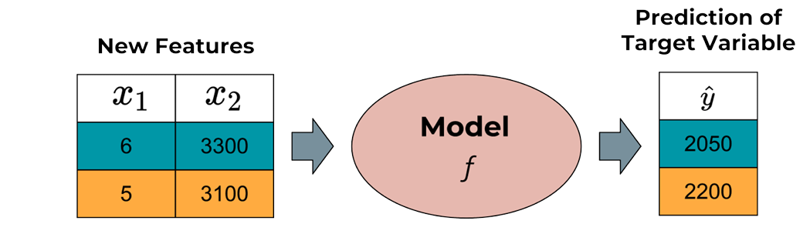
Models
A model (or hypothesis) is a function that maps feature vectors to predicted target values
y = f(X; θ)
Where:
y : Target Variable
X : vector of input features
Θ :Parameters that needs to be learned from the data
f is meant to capture intrinsic patterns of the data, the underlying assumption being that these hold true for all data drawn from Pxy

Slide 19
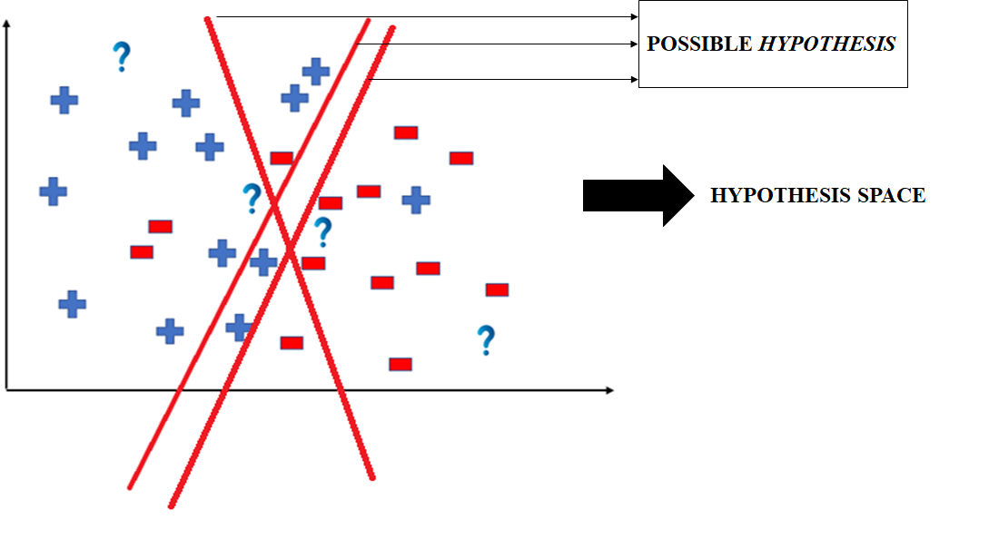
Models in Hypothesis Space
To find a "good" model, we must first decide on a specific type of model. This limits the options and makes the task manageable.
This predefined type is called a structural prior. The set of functions for this model type is the hypothesis space (H):
H={f:f belongs to a specific functional family}.

Slide 20
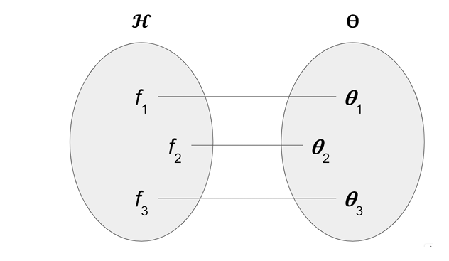
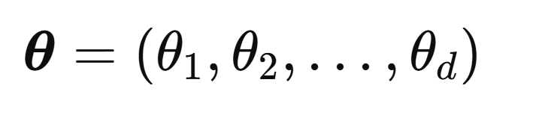
Parameterization
We collect all parameters in a parameter vector
from parameter space Θ.
So,
Finding the optimal model is perfectly equivalent to finding the optimal set of parameter values.

Slide 21
How?
How do we fit or train the model so we get best set of parameters?
How do we determine which set of parameters best fits our function or model?

Slide 22
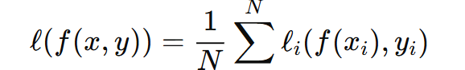
Cost Function
A cost function measures how well a model’s predictions match the actual target values. It quantifies the error.
Goal: Find parameters that minimize the loss (Empirical Risk Minimization)
A big part of machine learning focuses on the question, how to do this
minimization efficiently?

Slide 23
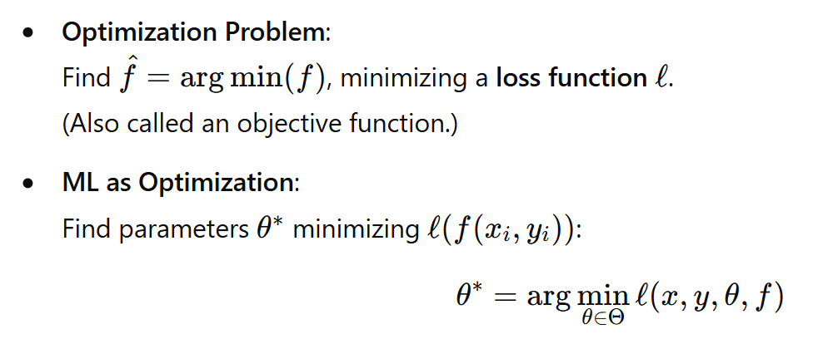
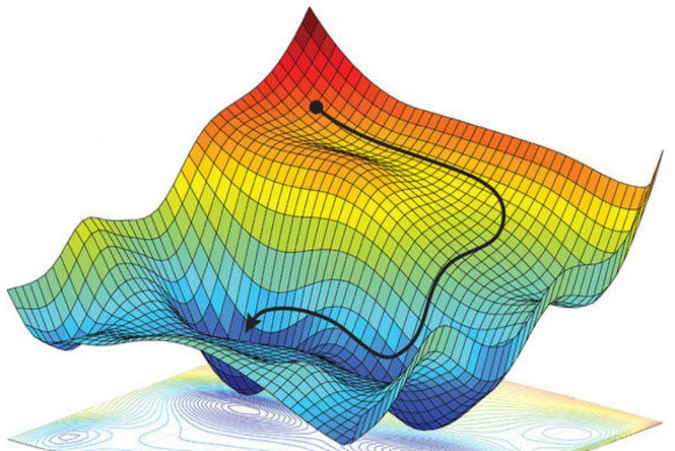
Optimization Process
Methods to Solve for θ∗:
Analytic solutions
Random search.
Systematic search.
Gradient-based numeric methods.

Slide 24
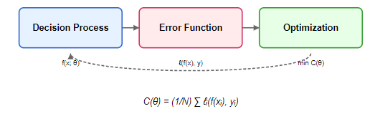
Summary: Machine Learning (ERM framework)
Decision Process/Function
Error Function
Optimization Process

Slide 25
How good is your model?
Idea of Generalization!

Slide 26
Bias Variance Tradeoff
• Models with high bias will have low variance.
• Models with high variance will have a low bias.
The idea is to find a “sweet spot”.
Underfitting zone
Overfitting zone
Generalization error
Bias
Variance
Model complexity

Slide 27
Understanding Classification Task (With Logistic Regression Algorithm)

Slide 28
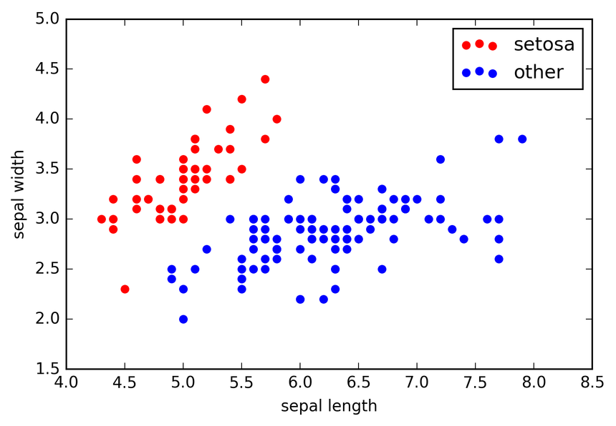
Linear Models
Separate classes using a linear decision boundary
Simple, interpretable, and computationally efficient
Common examples: Logistic Regression, SVM etc

Slide 29
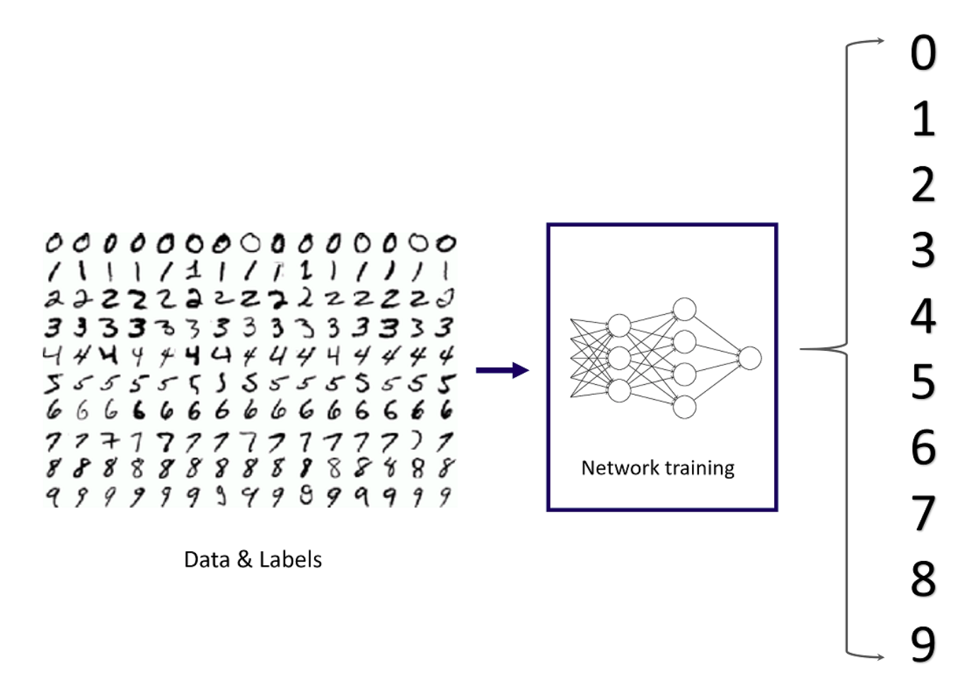
Classification
Process of categorizing a given set of data into classes,
We estimate a function that maps input variables to discrete output variables
Two types of classification task:
Binary
Multi-class
Copyright of the images used belongs to creator themselves.

Slide 30
Take a look at this example
Name | Weight | Is Obese?
Chandler | 80 | 1
Monica | 52 | 0
Phoebe | 58 | 0
Rachel | 55 | 0
Ross | 75 | 0
Joey | 79 | 1

Slide 31
Logistic Regression Motivation
Chandler (80)
Joey (79)
Obese
Monica (52)
Phoebe (58)
Rachel (55)
Ross (75)
Not Obese
Weight

Slide 32
Logistic Regression Motivation
Obese
Not Obese
Weight

Slide 33
In Linear Model
We considered using a linear regression model to represent these probabilities
p(X) = β0 + β1 X
Obese
Not Obese
Weight

Slide 34
Problem with linear model (In the classification task)
We considered using a linear regression model to represent these probabilities
p(X) = w0 + w1 X
Obese
Not Obese
Weight

Slide 35
The Logistic Model

Slide 36
The Logistic Model
Rather than modeling the response Y directly, the logistic regression models the probability that Y belongs to a particular category.
Pr( obese = Yes | weight )
One might predict obese = Yes for any individual for whose p(weight) > 0.5.
For a more conservative approach, you may choose to use a lower threshold, such as p(weight) > 0.1.

Slide 37
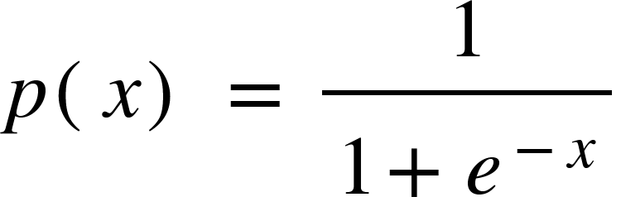
The Logistic Model
So, a linear model is expressed as a linear function
p(X) = w0 + w1 X
But the logistic model can be expressed as a logistic function a.k.a sigmoid function

Slide 38
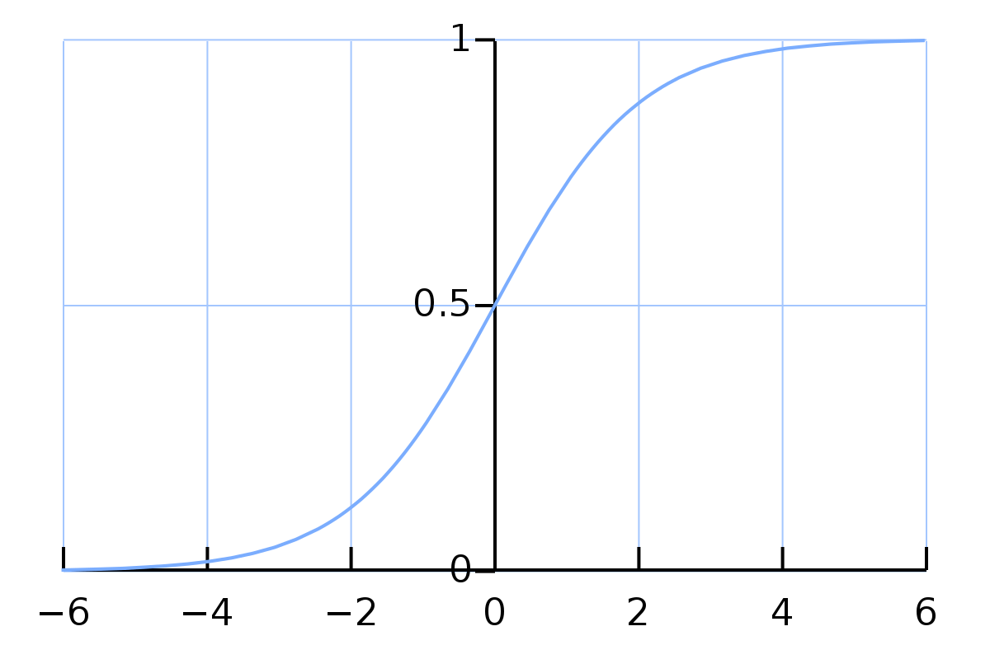
The Sigmoid Graph
Copyright of the images used belongs to creator themselves.

Slide 39
We need to fit a sigmoid function like below
1
0
Weight

Slide 40
We need to fit a sigmoid function like below
1
0
Weight

Slide 41
How?

Slide 42
Gradient Descent

Slide 43
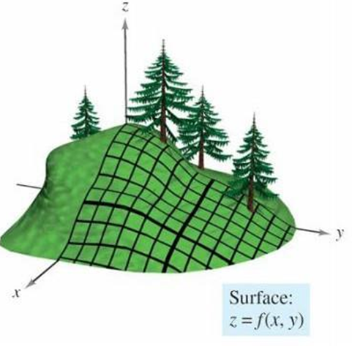
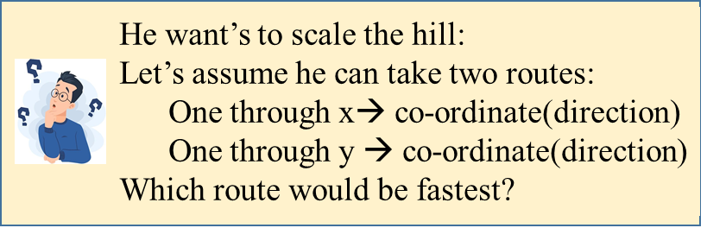
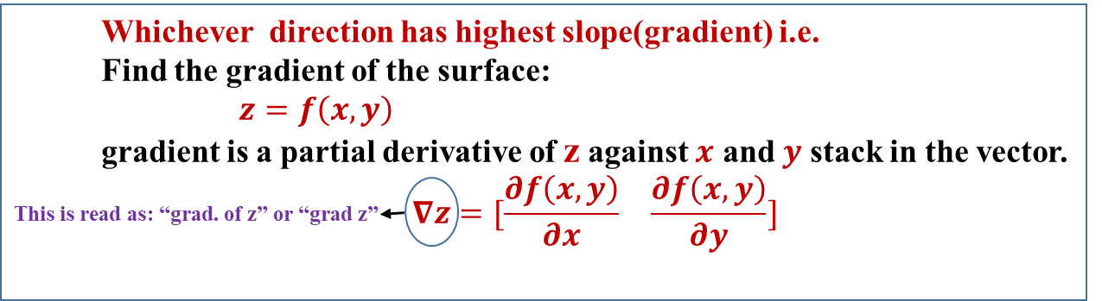
Gradient: Geometric Interpretation.
2/5/2025
W05 - Linear Models for Regression.
60

Slide 44
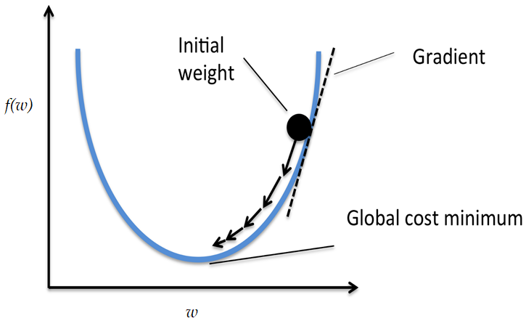
Gradient Descent

Slide 45
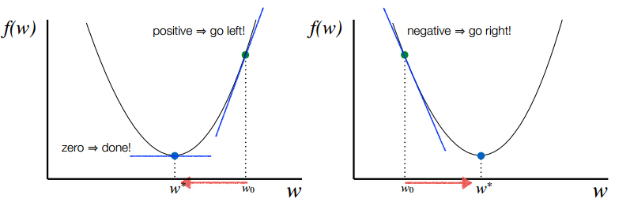
Gradient Descent

Slide 46
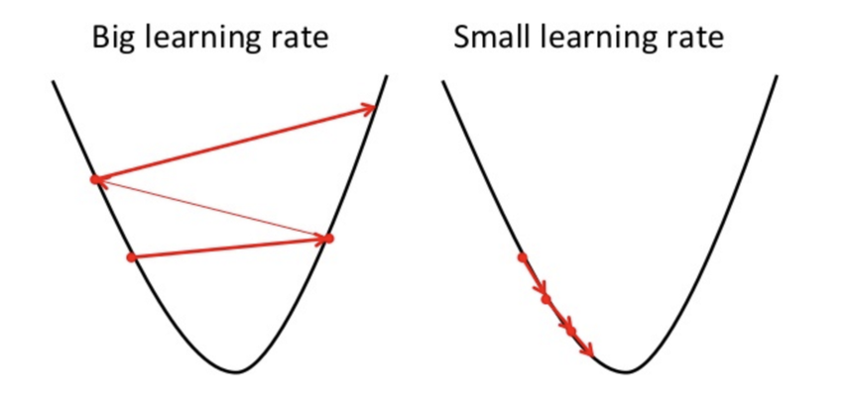
Learning Rate
How big steps to take?

Slide 47
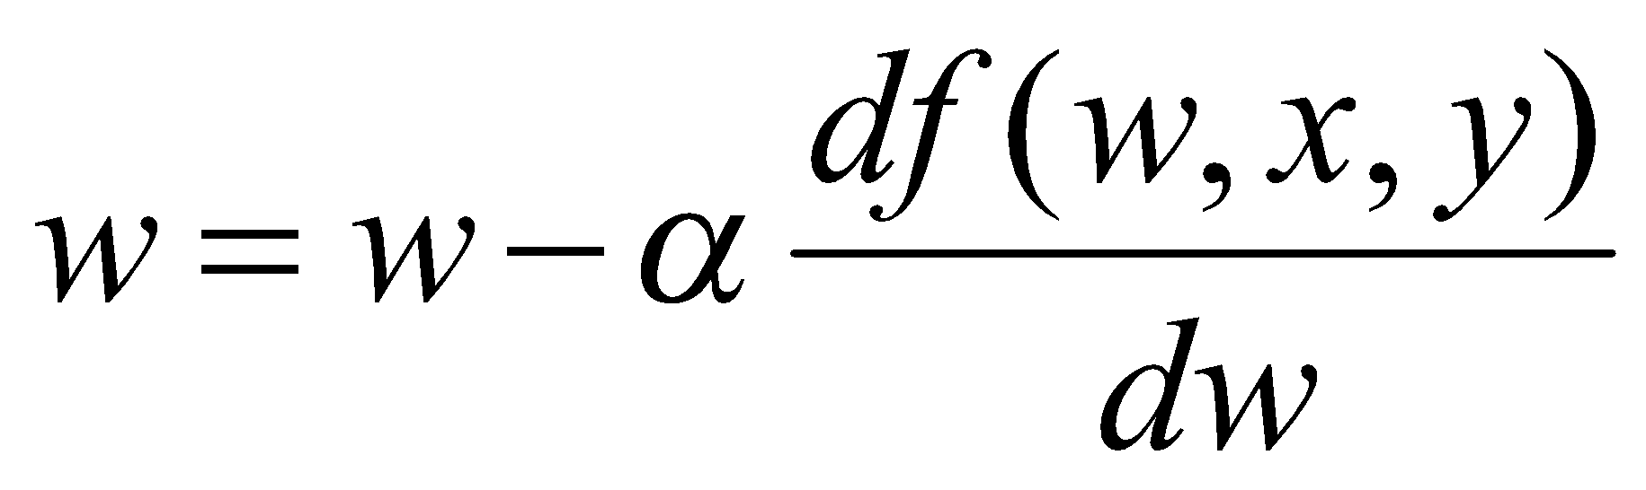
Goal?
To minimize f(w) iteratively using the error on the predictions to update the model in such a way as to reduce the error.
What is f(w)?

Slide 48
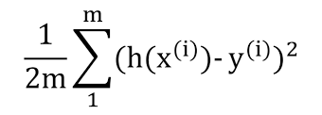
Cost Function
The cost function for linear regression is J(θ) =
J(θ)
Stuck in the local minima
But Logistic Regression has
Non-convex loss function
θ₁
θ₁
Need to reach here

Slide 49
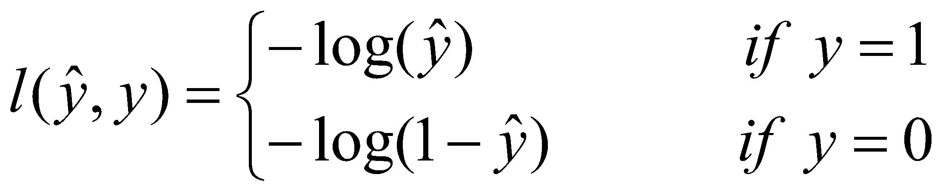
Cost Function
Logistic Regression cost function

Slide 50
Cost Function (Logistic Regression)
Logistic Regression cost function
cost(h_{θ}(x),y)
log(h_{θ}(x))
h_{θ}(x)
0
1

Slide 51
Cost Function
Logistic Regression cost function

Slide 52
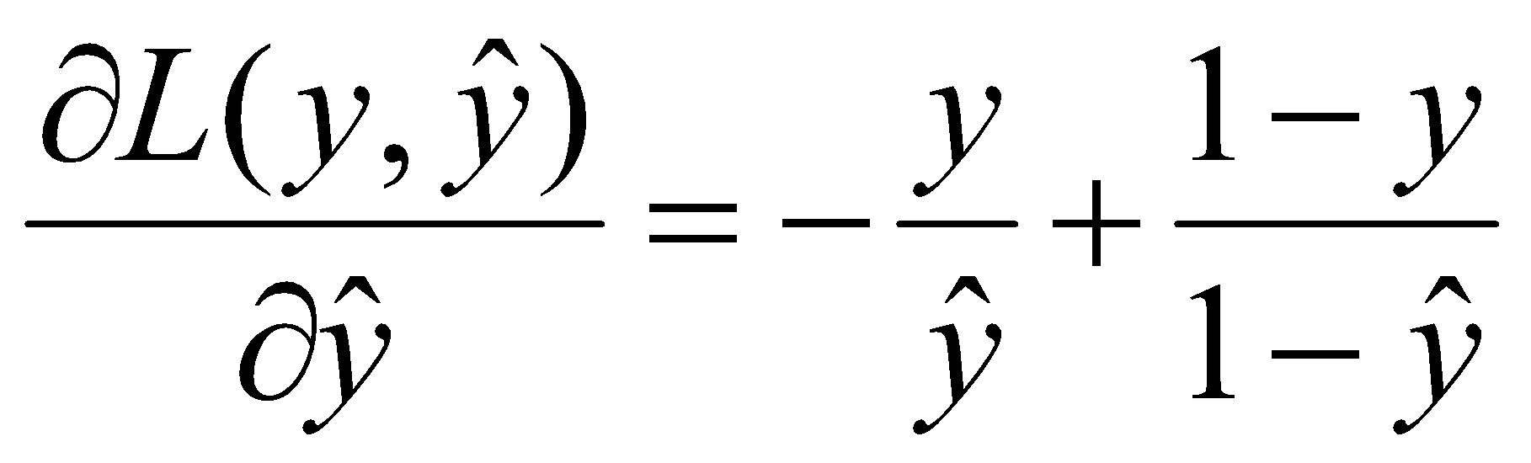
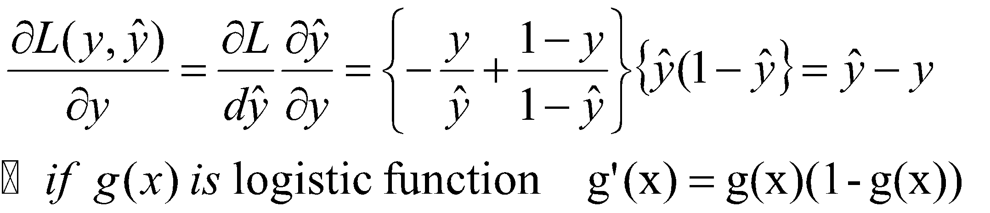
Logistic Regression GD/Derivatives

Slide 53
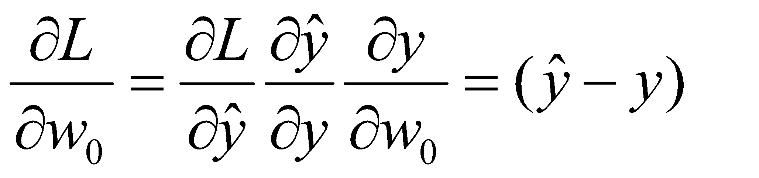
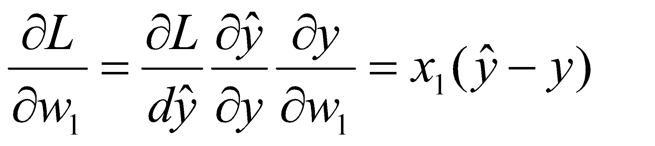
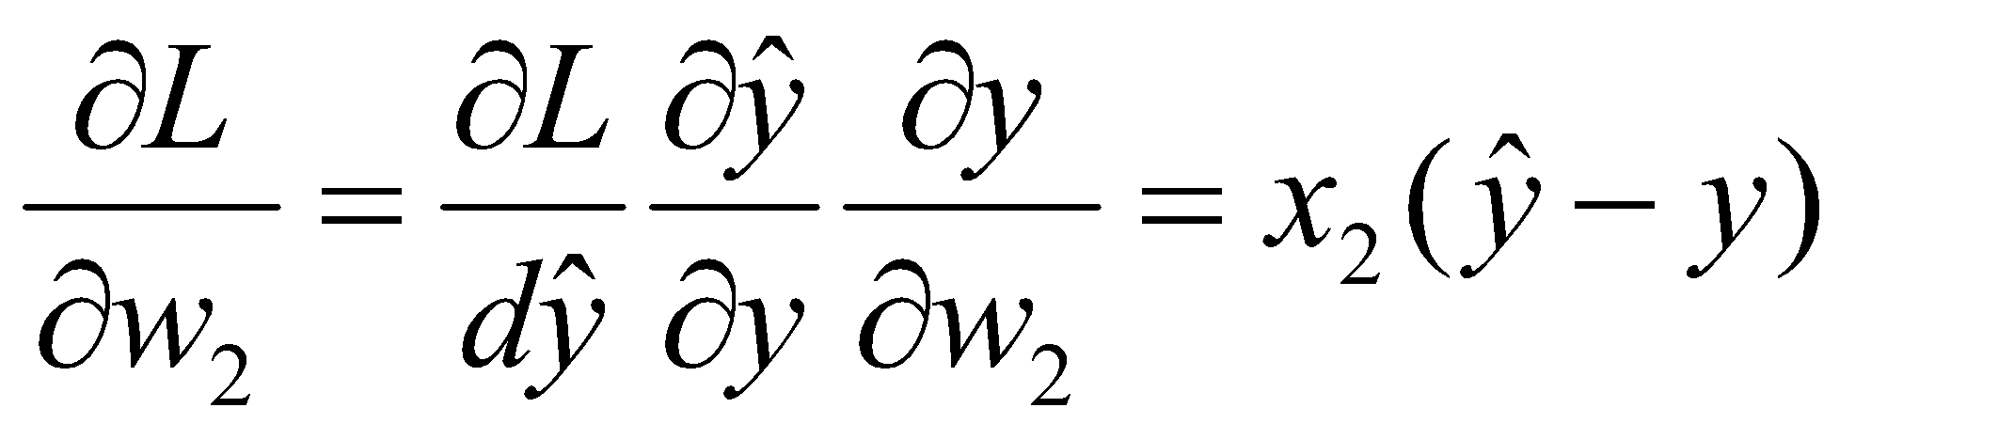
Logistic Regression GD/Derivatives

Slide 54
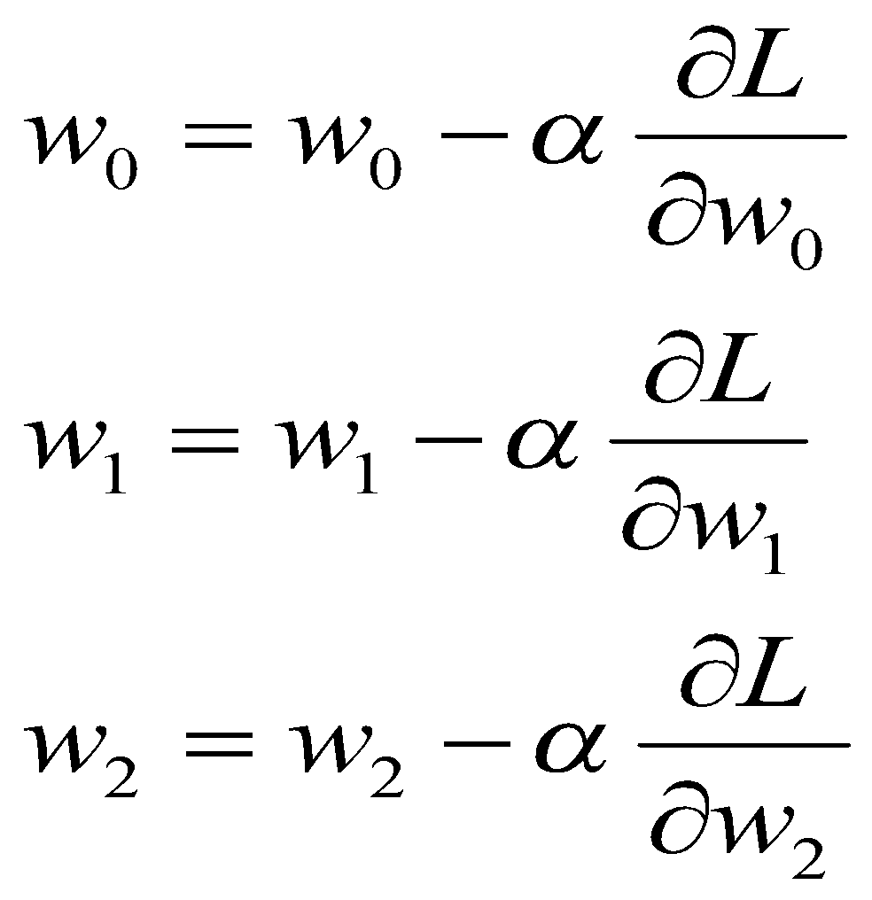
Logistic Regression
Thus, parameters of Logistic Regression are updated as below:

Slide 55
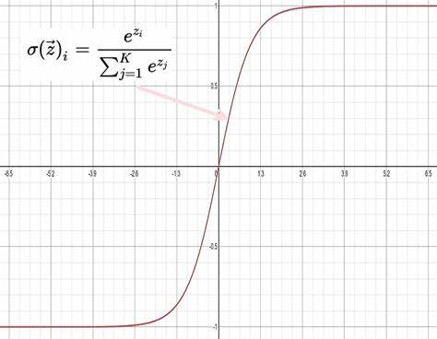
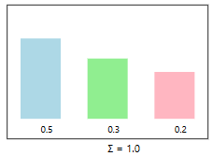
Multiclass Classification (Soft max Function)

Slide 56
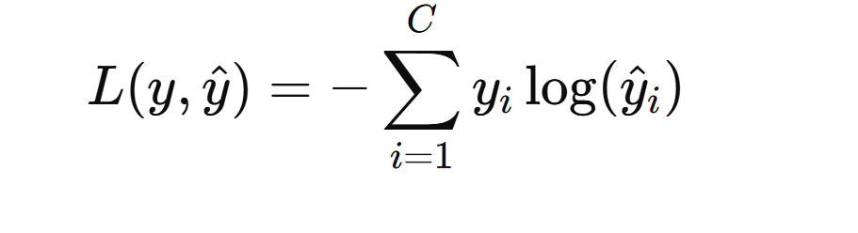
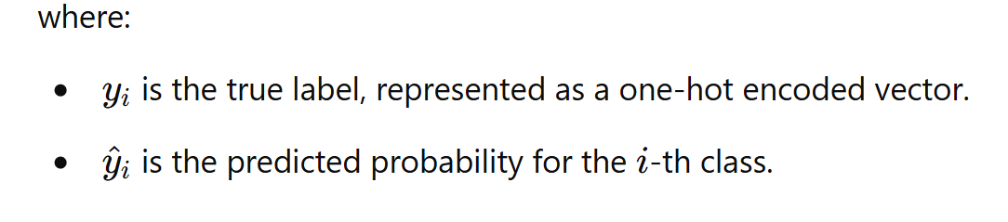
Cost function generalization

Slide 57
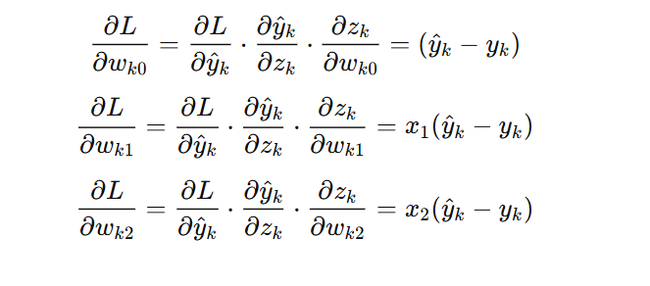
Derivative of Cost function

Slide 58
How Good is your Model?
Evaluating Classification Models!

Slide 59


Confusion Matrix
Actually +ve
Actually -ve
Predicted +ve
True Positive
False Positive
Predicted -ve
False Negative
True Negative
Copyright of the images used belongs to creator themselves.

Slide 60
Confusion Matrix
Actually +ve
Actually -ve
Predicted +ve
True Positive
False Positive
Predicted -ve
False Negative
True Negative
Accuracy = (TP+TN) / (TP+TN+FP+FN)

Slide 61
Confusion Matrix
Actually +ve
Actually -ve
Predicted +ve
True Positive
False Positive
Predicted -ve
False Negative
True Negative
Precision = TP / (TP+FP)

Slide 62
Confusion Matrix
Actually +ve
Actually -ve
Predicted +ve
True Positive
False Positive
Predicted -ve
False Negative
True Negative
Recall = TP / (TP+FN)

Slide 63
Confusion Matrix
Actually +ve
Actually -ve
Predicted +ve
True Positive
False Positive
Predicted -ve
False Negative
True Negative
F1 Score = 2 * Precision * Recall / (Precision+Recall)

Slide 64
AUC-ROC Curve
How good the model can predict each classes
ROC (Receiver Operating Characteristic) curve is a visualization of false positive rate (x-axis) and the true positive rate (y-axis).
True positive rate
False positive rate

Slide 65
Discussion?

Slide 66
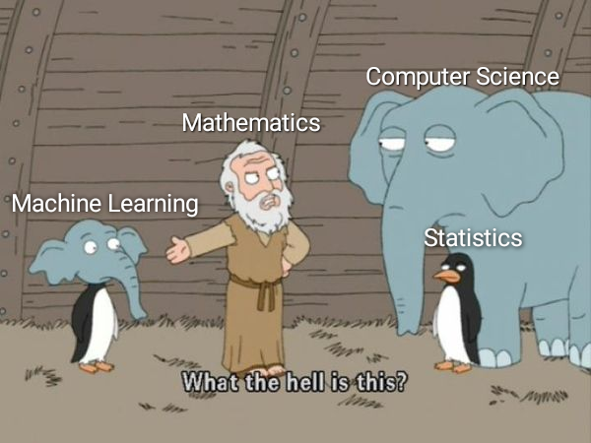
Thank You!

